Slide 1

AusSeabed Workshop 4 – AMSA
Adelaide University, 3rd July 2018
Presented by Adam Lewis¹ on behalf of K. Picard¹, T. Whiteway¹, R. Nanson¹, V. Lucieer², R. Przeslawski¹, S. Nichol¹, J. Smith¹, A. Post¹, Z. Huang¹, J. Guinan³
Facilitators: Kim Picard (GA), Dan Ierodiaconou (Deakin), Nathan Quadros (FrontierSI), and Ralph Talbot-Smith (WA DoT)
¹ Geoscience Australia; ² Institute of Marine and Antarctic Studies; ³ Geological Survey of Ireland

Slide 2
Workshop agenda:
18:30-18:45 What is AusSeabed and Updates on AusSeabed initiatives
18:45-19:45 QA4MBES (Nathan and Sam, FrontierSI)
Break
20:00 - 21:00 Data discoverability and accessibility (Dan, Deakin Uni & Kim, GA)
21:00 - 21:30 AusSeabed Steering committee and directions (Ralph, WA DoT)
21:30 - 21:45 AusSeabed and Seabed 2030

Slide 3


Notes:
AusSeabed is becoming the national coordination program for seabed mapping in Australia (Click). It is managed and facilitated by GA and is firstly focused on multibeam data.
Australian Government initiative started late 2016 represented by Governments, Universities and Industry to develop initiatives and products to improve the quality, discoverability and accessibility of seabed mapping data for the Australian community.
There are presently 19 partners and is a growing initiative that is picking up momentum which reflects the need for seabed mapping coordination in Australia. The next few slides will describe the projects under-development and their progress/future plan.

Slide 4
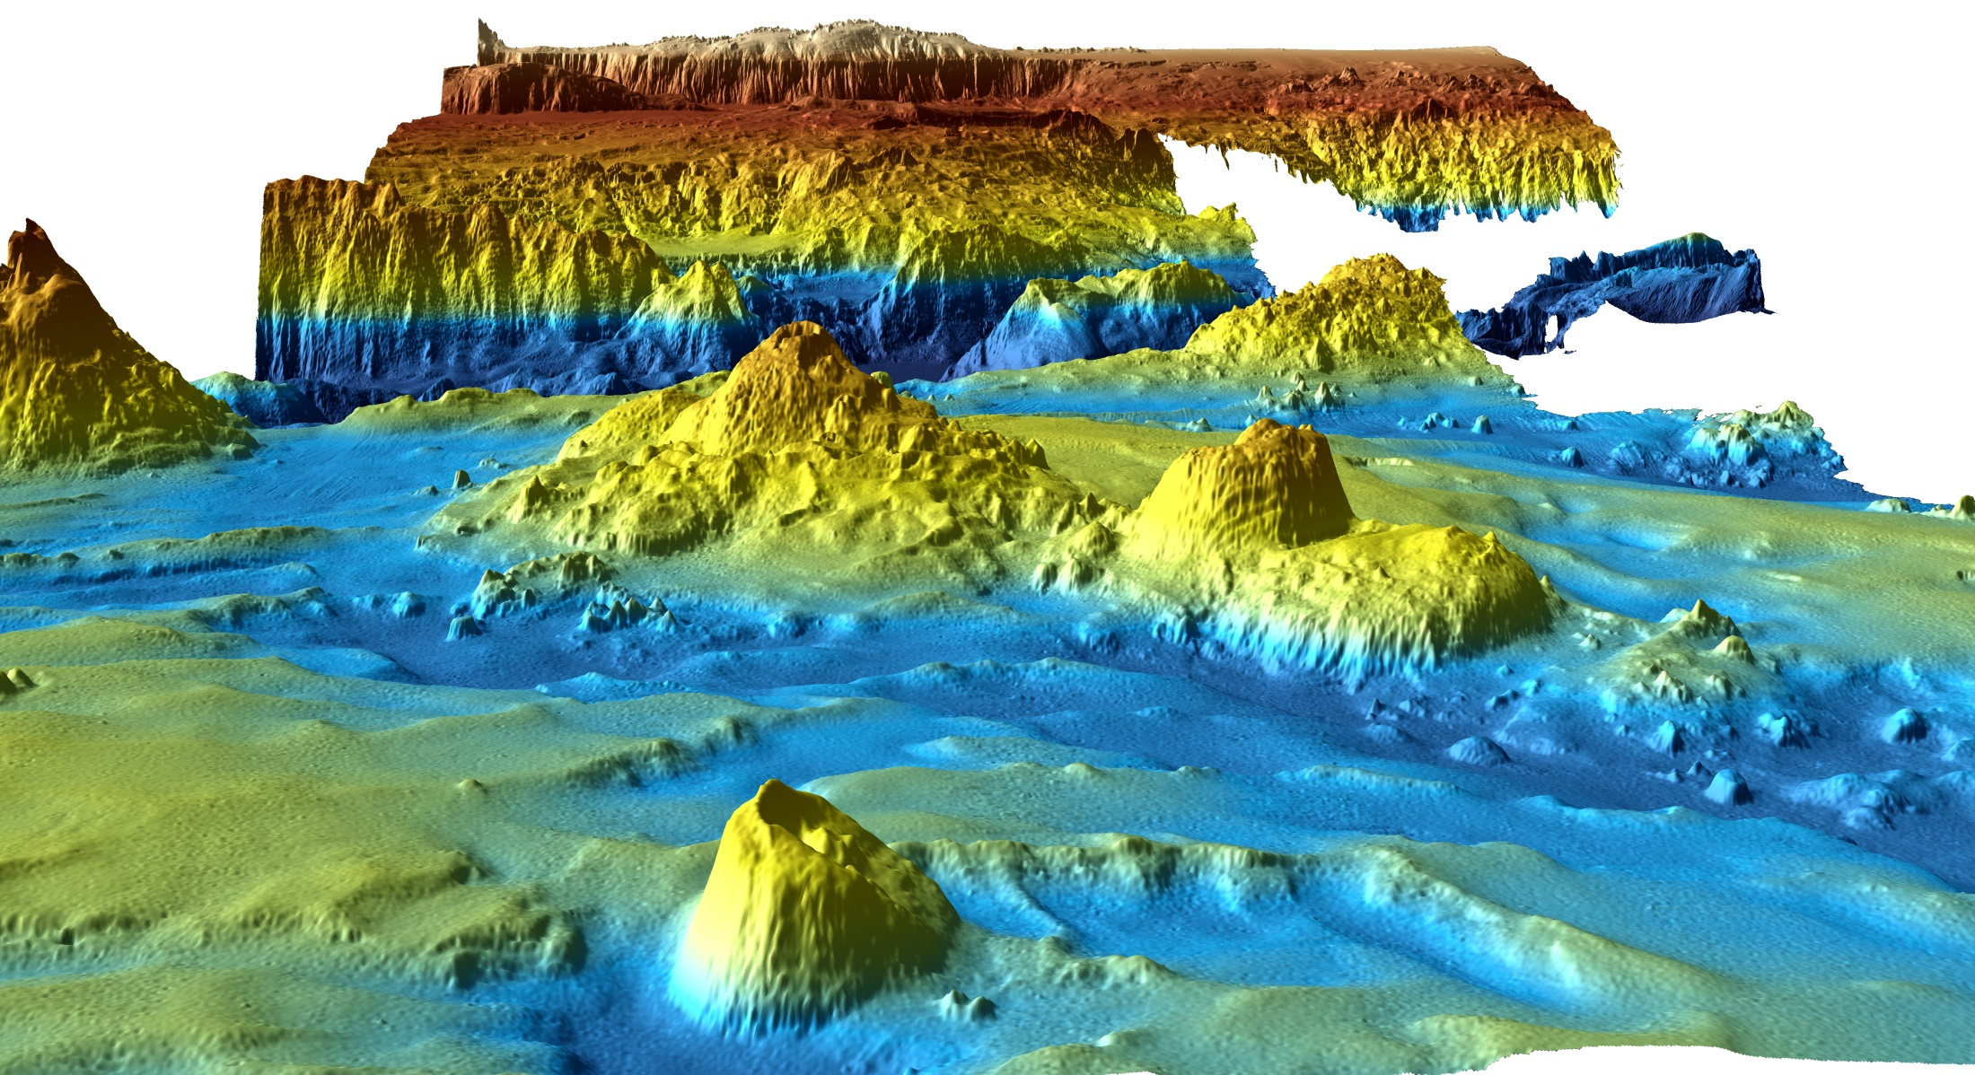

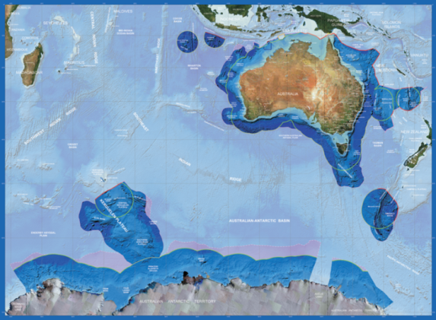
- Outcomes
promote collaboration and innovation
enable stakeholders to leverage Australia’s seabed mapping expertise and capabilities
identify and target areas where new data is needed most
reduce survey planning time & encourage better standards of data acquisition
increase data usage and discoverability
facilitate more robust scientific outputs
contribute to the better management of the Australian waters by facilitating decision-making

Slide 5
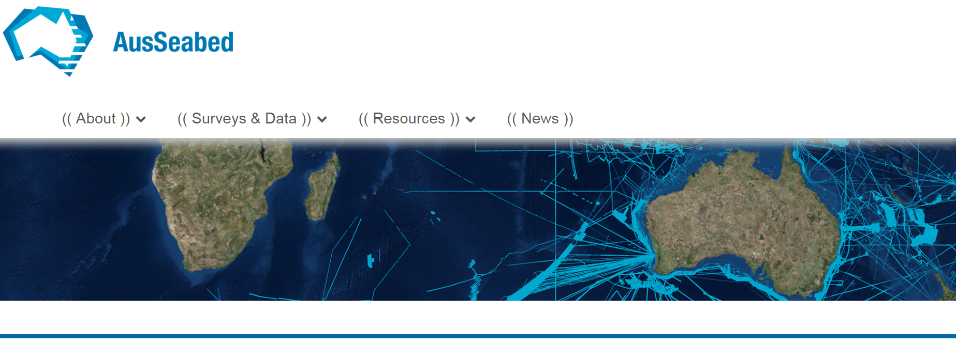
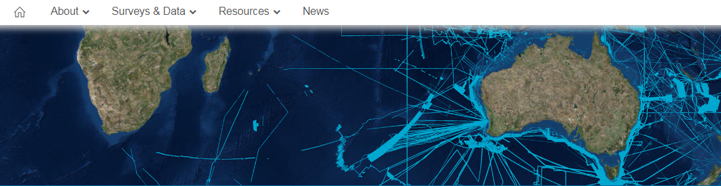

Initiatives
Tools and Utilities:
various tools to facilitate survey planning and data submission
AusSeabed.gov.au website: 1-stop shop for seabed mapping material
Guidelines
QA4MBES
Capability catalogue
Systems available
Presentation
Education
Permitting
Technical Resources

Slide 6
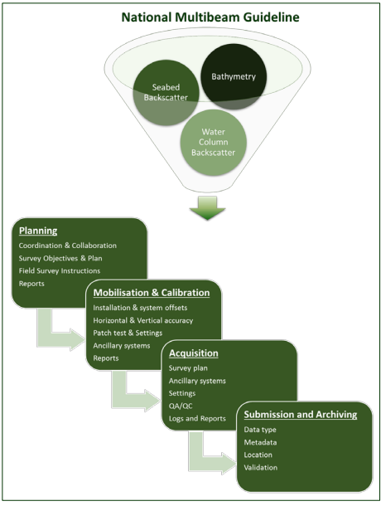

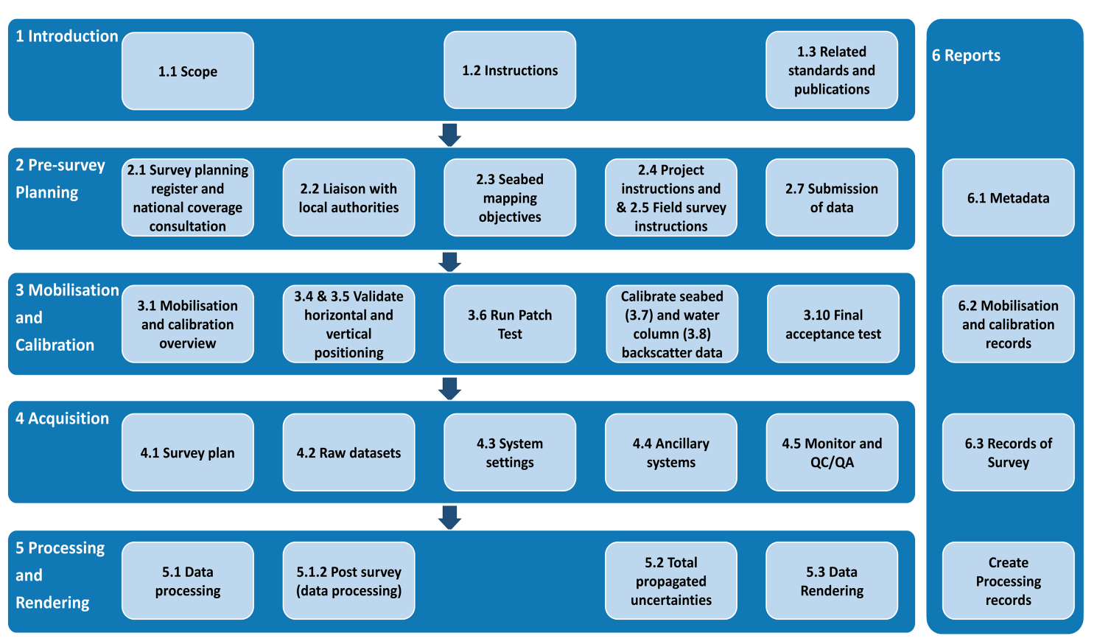

Initiatives
Initiatives
Guideline: National Multibeam guideline for experts and non-experts. Towards “Collect once, use many times
Notes:
The guidelines provide procedures mainly on survey planning, data acquisition and submission i.e. from the pre-survey planning phase to the data submission phase “off the ship”. They have been build by a committee of experts and non-experts from various fields of mapping. They are designed for a range of audiences, from those experienced in seafloor mapping using swath acoustic systems, non-experts who are developing mapping capabilities, and those contracting seafloor mapping surveys using swath systems.
These guidelines aim to improve interoperability, discoverability and accessibility of swath system data, and encourage improved acquisition standards to meet more user requirements. Collect once, use many times
They should be used as an overarching document, providing a minimum set of requirements for seafloor mapping activities conducted in Australian waters. They should be supplemented by application-specific requirements.
Version 1 will be published imminently and the intention is to continue maintaining it, so as to reflect the changes in survey ‘habits’ following better awareness of the needs of the various user-groups through AusSeabed collaboration. We expect that as data quality and interoperability grows, national guidelines and requirements will be tightened..

Slide 7
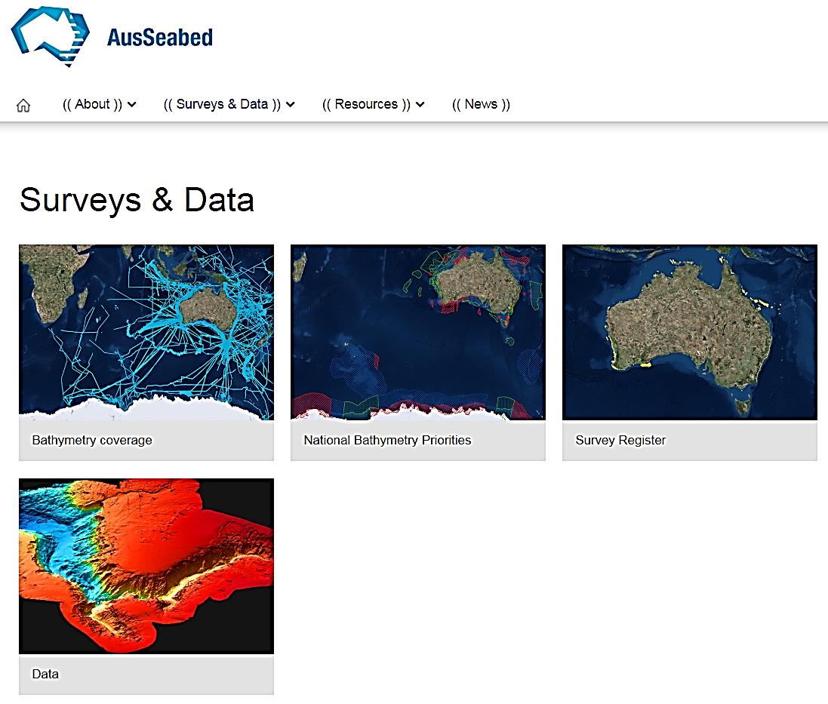

Initiatives
Collating coverage for all MBES data
Developing a Gov. priority map
Upcoming Survey Register:
Improve communication, collaboration, and better use of national resources
Data discoverability plans:
Developing a cross-entities cloud-shared and distributed storage file management platform
Accessibility from end-user through point cloud delivery system.

Slide 8
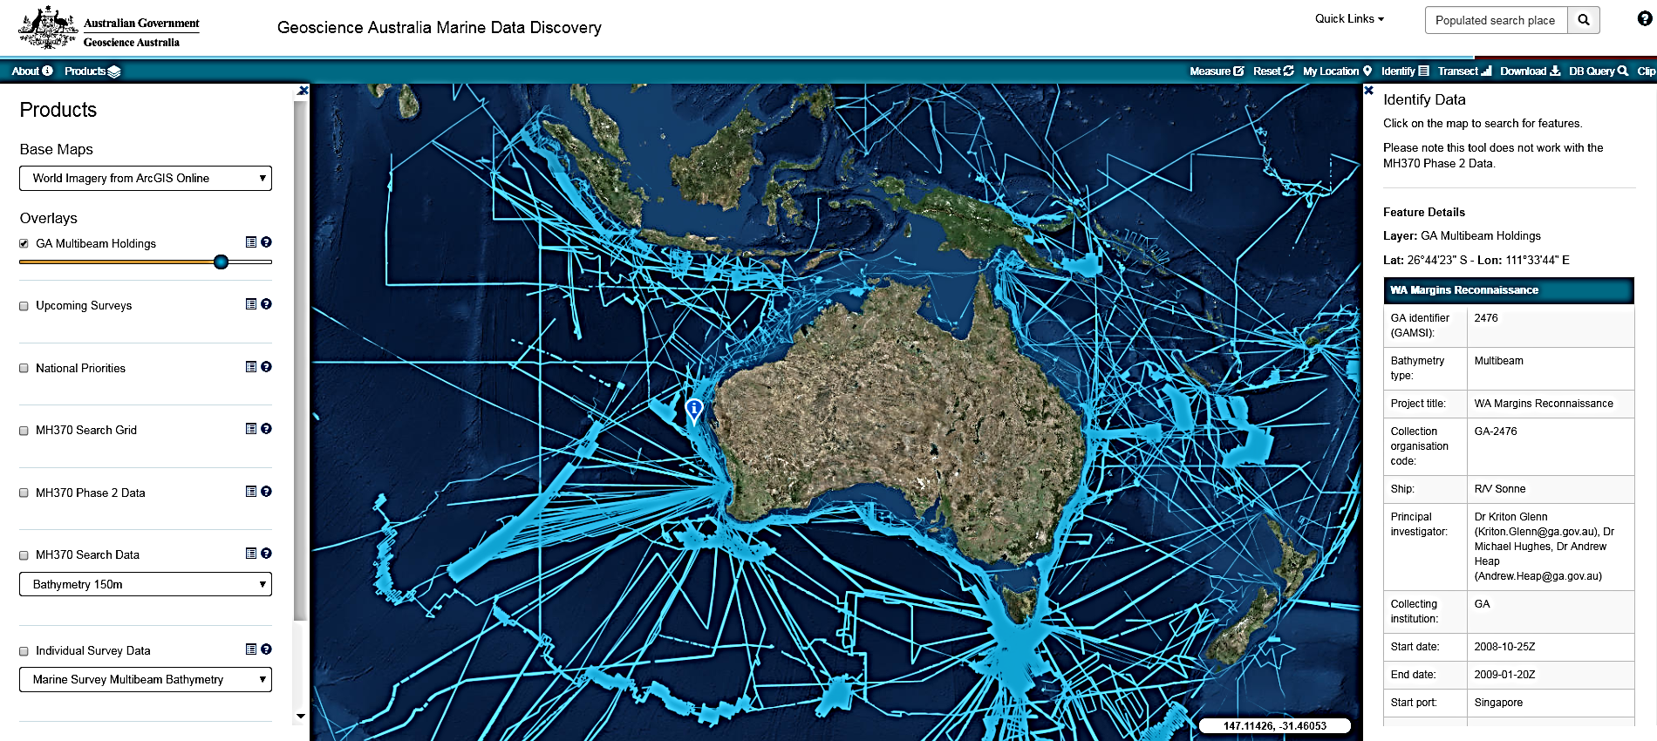
Coverage

Slide 9
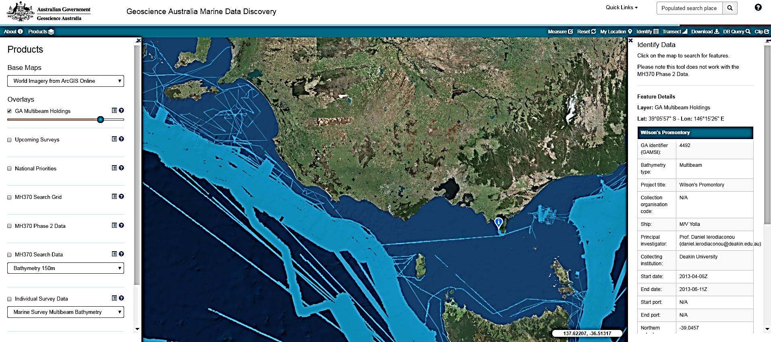
Coverage

Slide 10
Initiatives
Collating coverage for all MBES data
Developing a Gov. priority map
Upcoming Survey Register:
Improve communication, collaboration, and better use of national resources
Data discoverability plans:
Developing a cross-entities cloud-shared and distributed storage file management platform
Accessibility from end-user through point cloud delivery system.

Slide 11
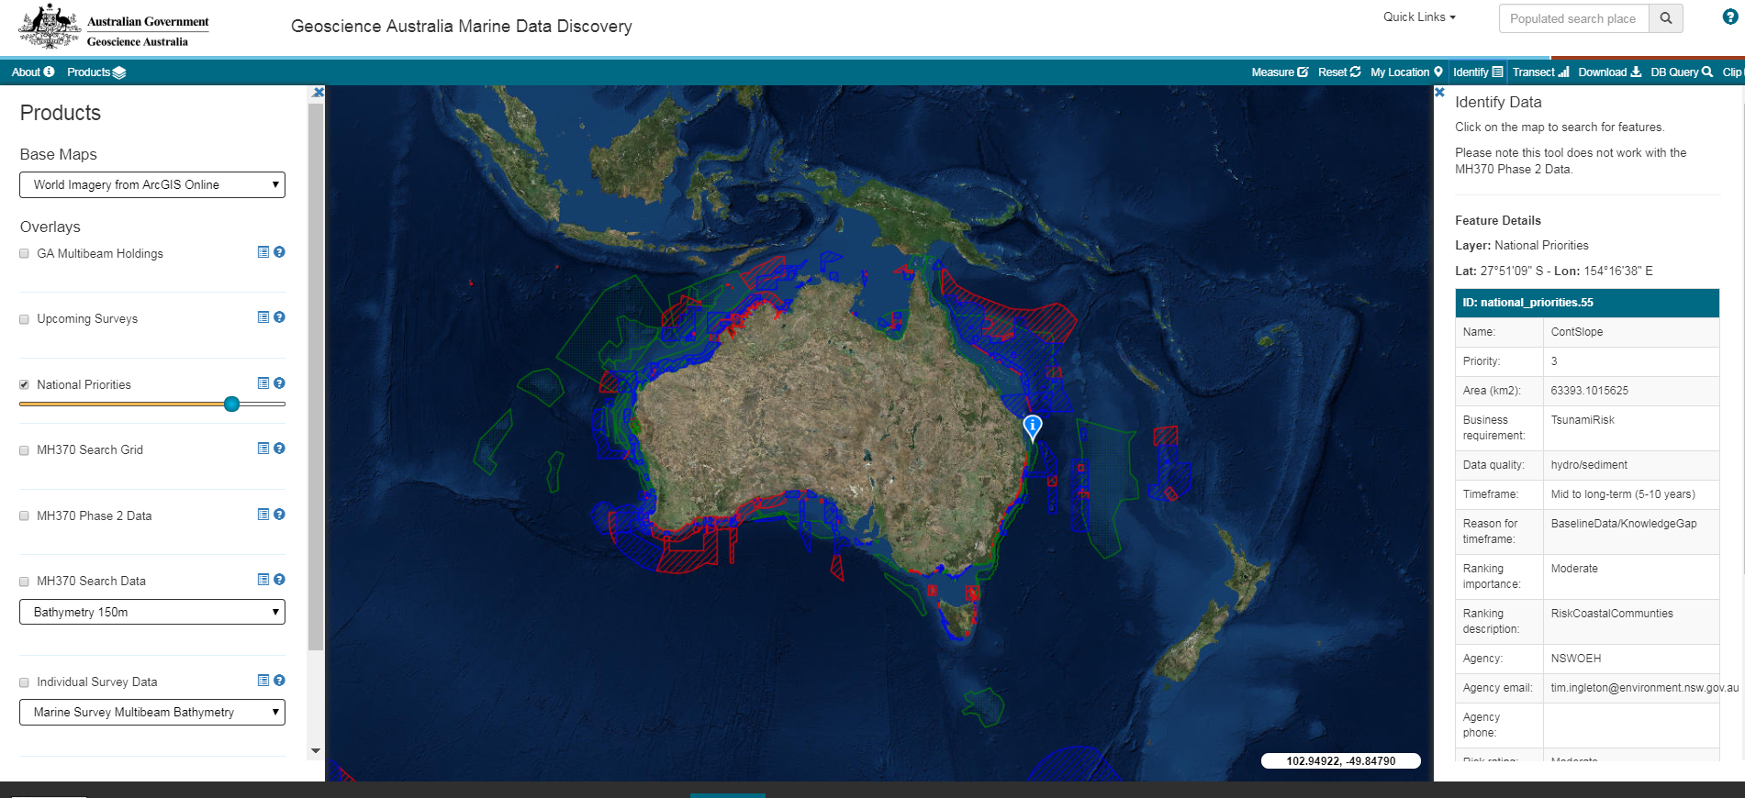

National Priority

Slide 12
Initiatives
Collating coverage for all MBES data
Developing a Gov. priority map
Upcoming Survey Register:
Improve communication, collaboration, and better use of national resources
Data discoverability plans:
Developing a cross-entities cloud-shared and distributed storage file management platform
Accessibility from end-user through point cloud delivery system.

Slide 13
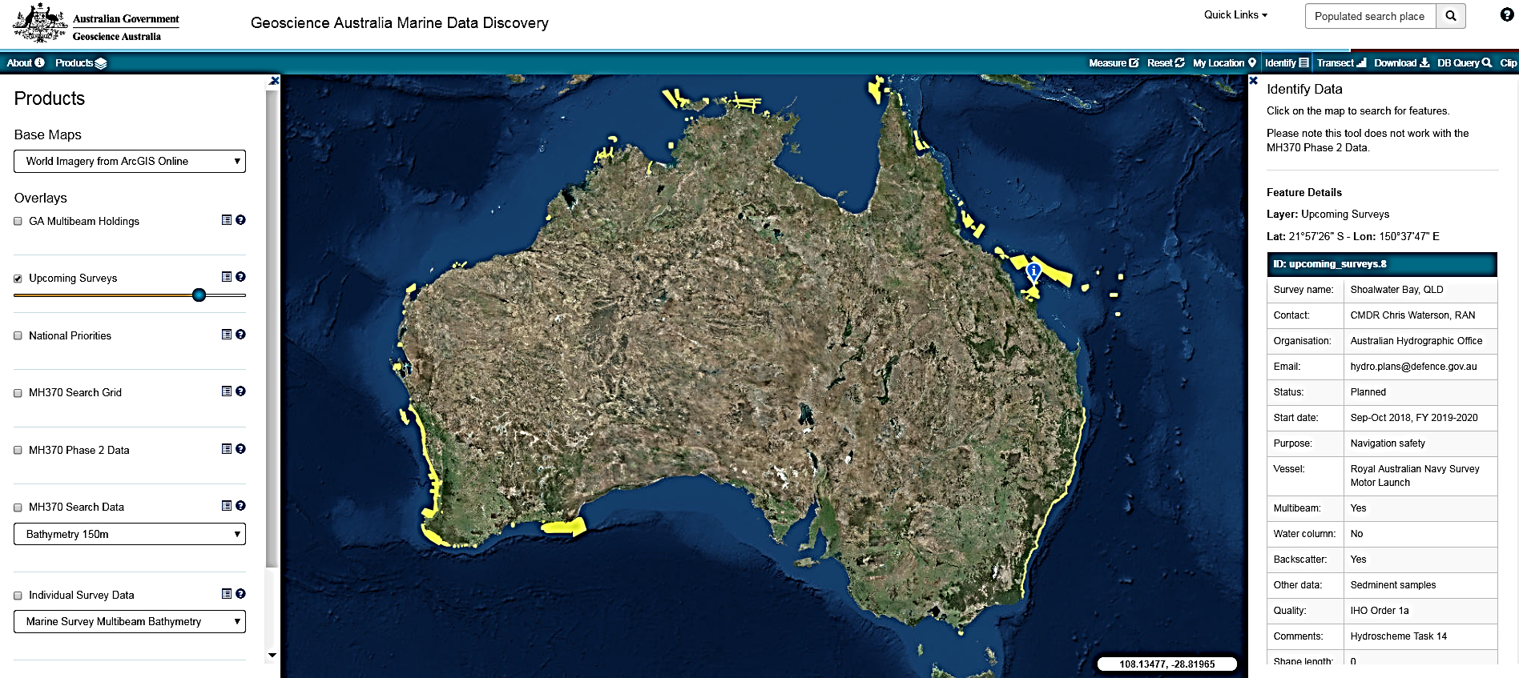
Upcoming surveys

Slide 14
Initiatives
Collating coverage for all MBES data
Developing a Gov. priority map
Upcoming Survey Register:
Improve communication, collaboration, and better use of national resources
Data discoverability plans:
Developing a cross-entities cloud-shared and distributed storage file management platform
Accessibility from end-user through point cloud delivery system.

Slide 15
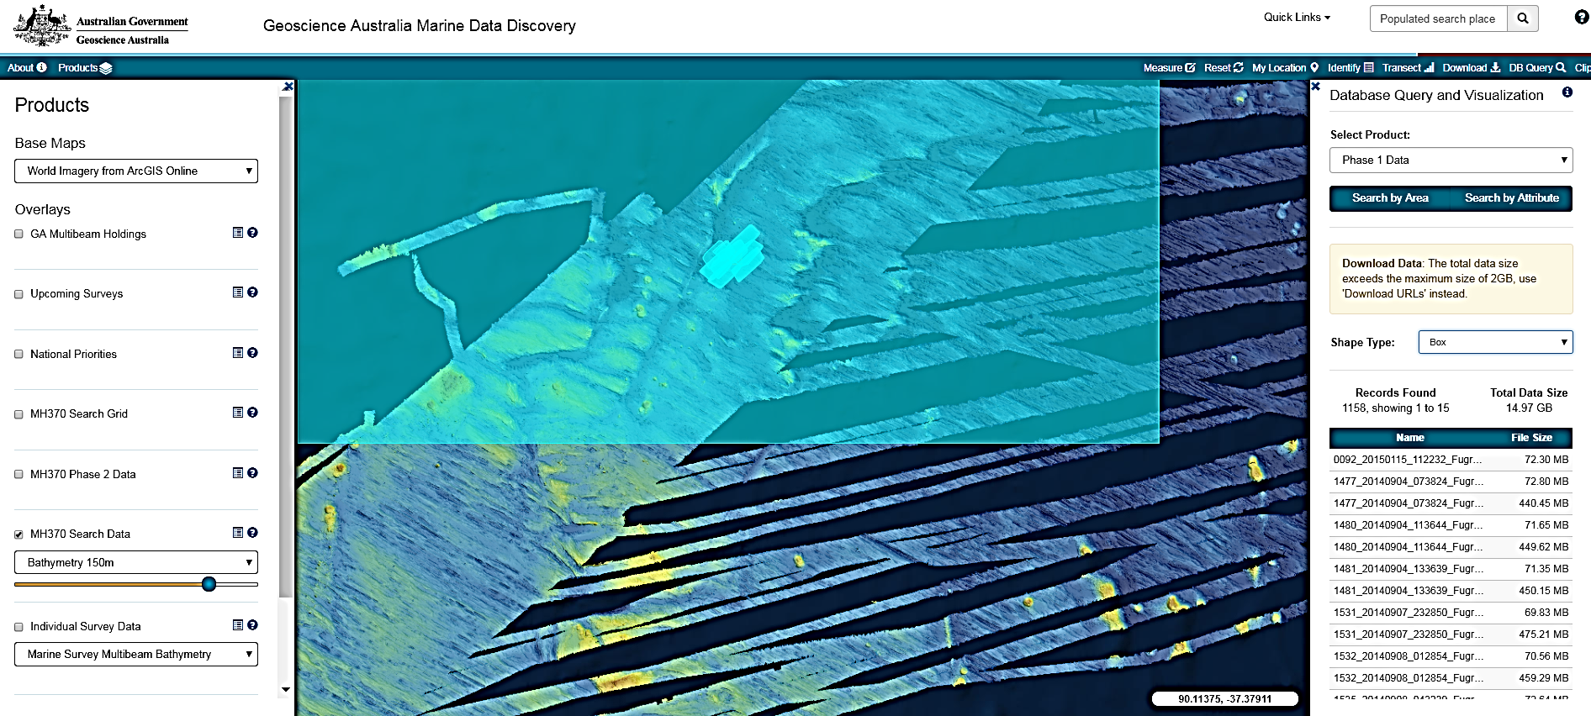
Data query and Download (eg. Based on engine developed for MH370 data)

Slide 16
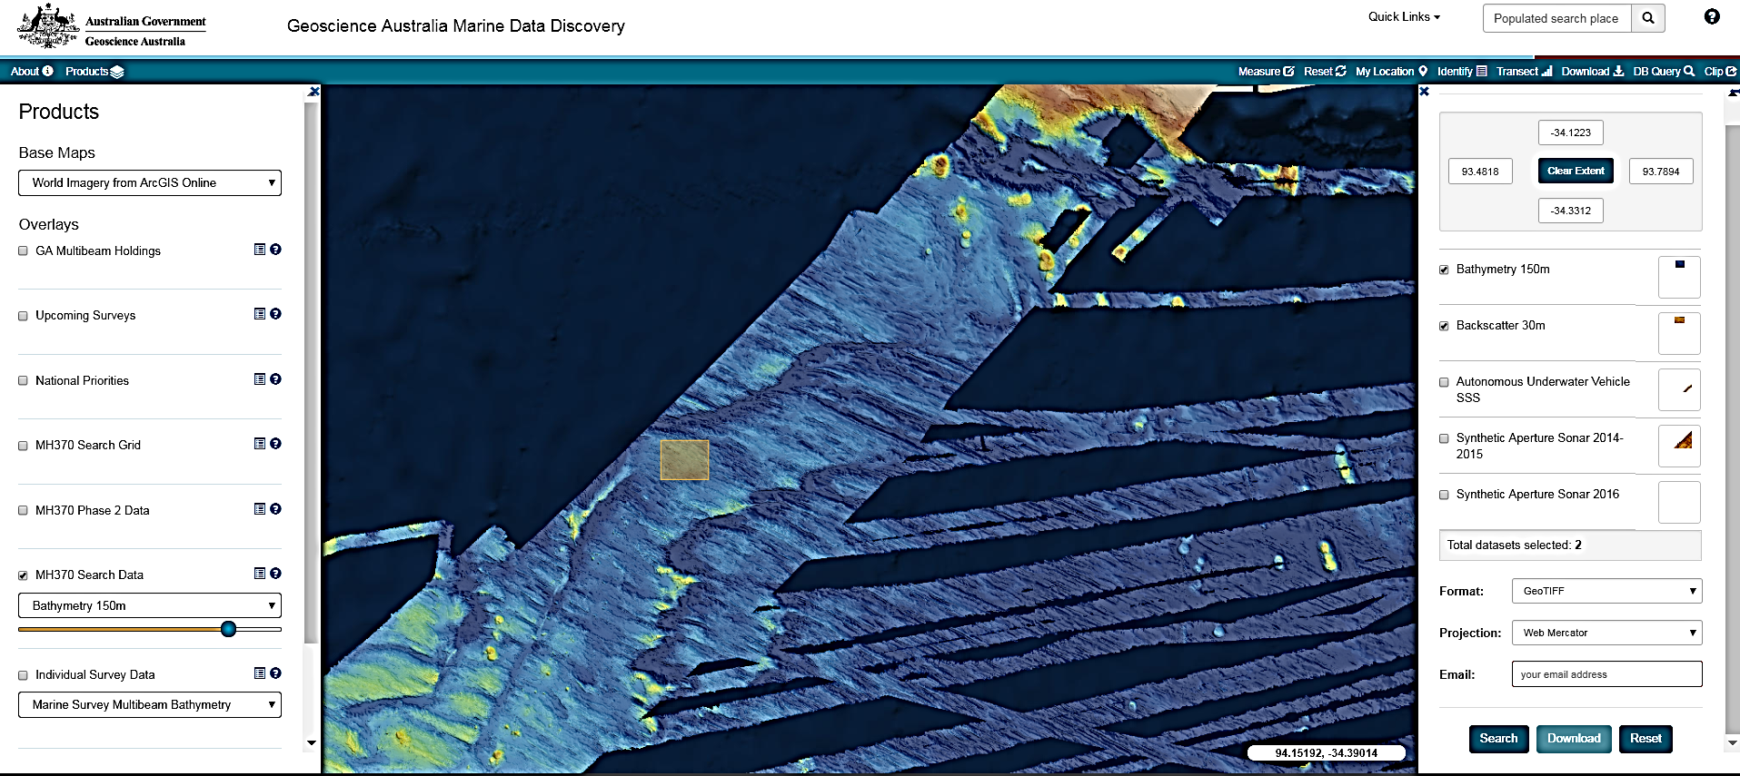
Data clip and ship

Slide 17
Comments
Please provide any comments to:
feedback sheet
AusSeabed@ga.gov.au
Kim or Aero

Slide 18
Workshop agenda:
18:30-18:45 What is AusSeabed and Updates on AusSeabed initiatives
18:45-19:45 QA4MBES (Nathan and Sam, FrontierSI)
Break
20:00 - 21:00 Data discoverability and accessibility (Dan, Deakin Uni & Kim, GA)
21:00 - 21:30 AusSeabed Steering committee and directions (Ralph, WA DoT)
21:30 - 21:45 AusSeabed and Seabed 2030

Slide 19
1. QA4MBES
Outcomes:
1. A list of user requirements for various applications of MBES in different domains
2. Feedback on the QA4MBES workflow.

Slide 20
Workshop agenda:
18:30-18:45 What is AusSeabed and Updates on AusSeabed initiatives
18:45-19:45 QA4MBES (Nathan and Sam, FrontierSI)
Break
20:00 - 21:00 Data discoverability and accessibility (Dan, Deakin Uni & Kim, GA)
21:00 - 21:30 AusSeabed Steering committee and directions (Ralph, WA DoT)
21:30 - 21:45 AusSeabed and Seabed 2030

Slide 21
2a. Data Discovery and accessibility
Background
Data discoverability is a pressing issue considering the seabed mapping programs and initiatives that are under way nationally and internationally.
Considering the collaborative nature and diversity of AusSeabed, the group is well placed to undertake discussion and provide a coordinated approach.
Outcomes
Data infrastructure
How to store and manage data
Existing coverage compilation
Should and how to compile coverage and who will lead this AusSeabed activity and how
Activity flow: 30 Minutes
Infrastructure:
Presentation of model strawman (10 min)
Break out group discussion (15 min)
Group discussion (15 min)
Coverage:
Group discussion on coverage (10 min)

Slide 22


Proposed data infrastructure model
Local Hub
Hydrographic
Office
Data Custodian
Firewall
Data Customer
QC & Package
metadata
National Hub
Ledger
managed by GA
Use
International stakeholders
(e.g. Seabed 2030)
like delivery
Local Hub
Geoscience
Australia
Data Custodian
Firewall
QC &
package
files
Local Hub
Other Governments
Data Custodian
Data supplier
to central repository
Firewall

Slide 23
Ideas behind the proposed model
Security
Functional redundancy through distributed platform
Transparency
Provenance
Custodianship retained
Deep Archive
Standardisation of platform and data

Slide 24
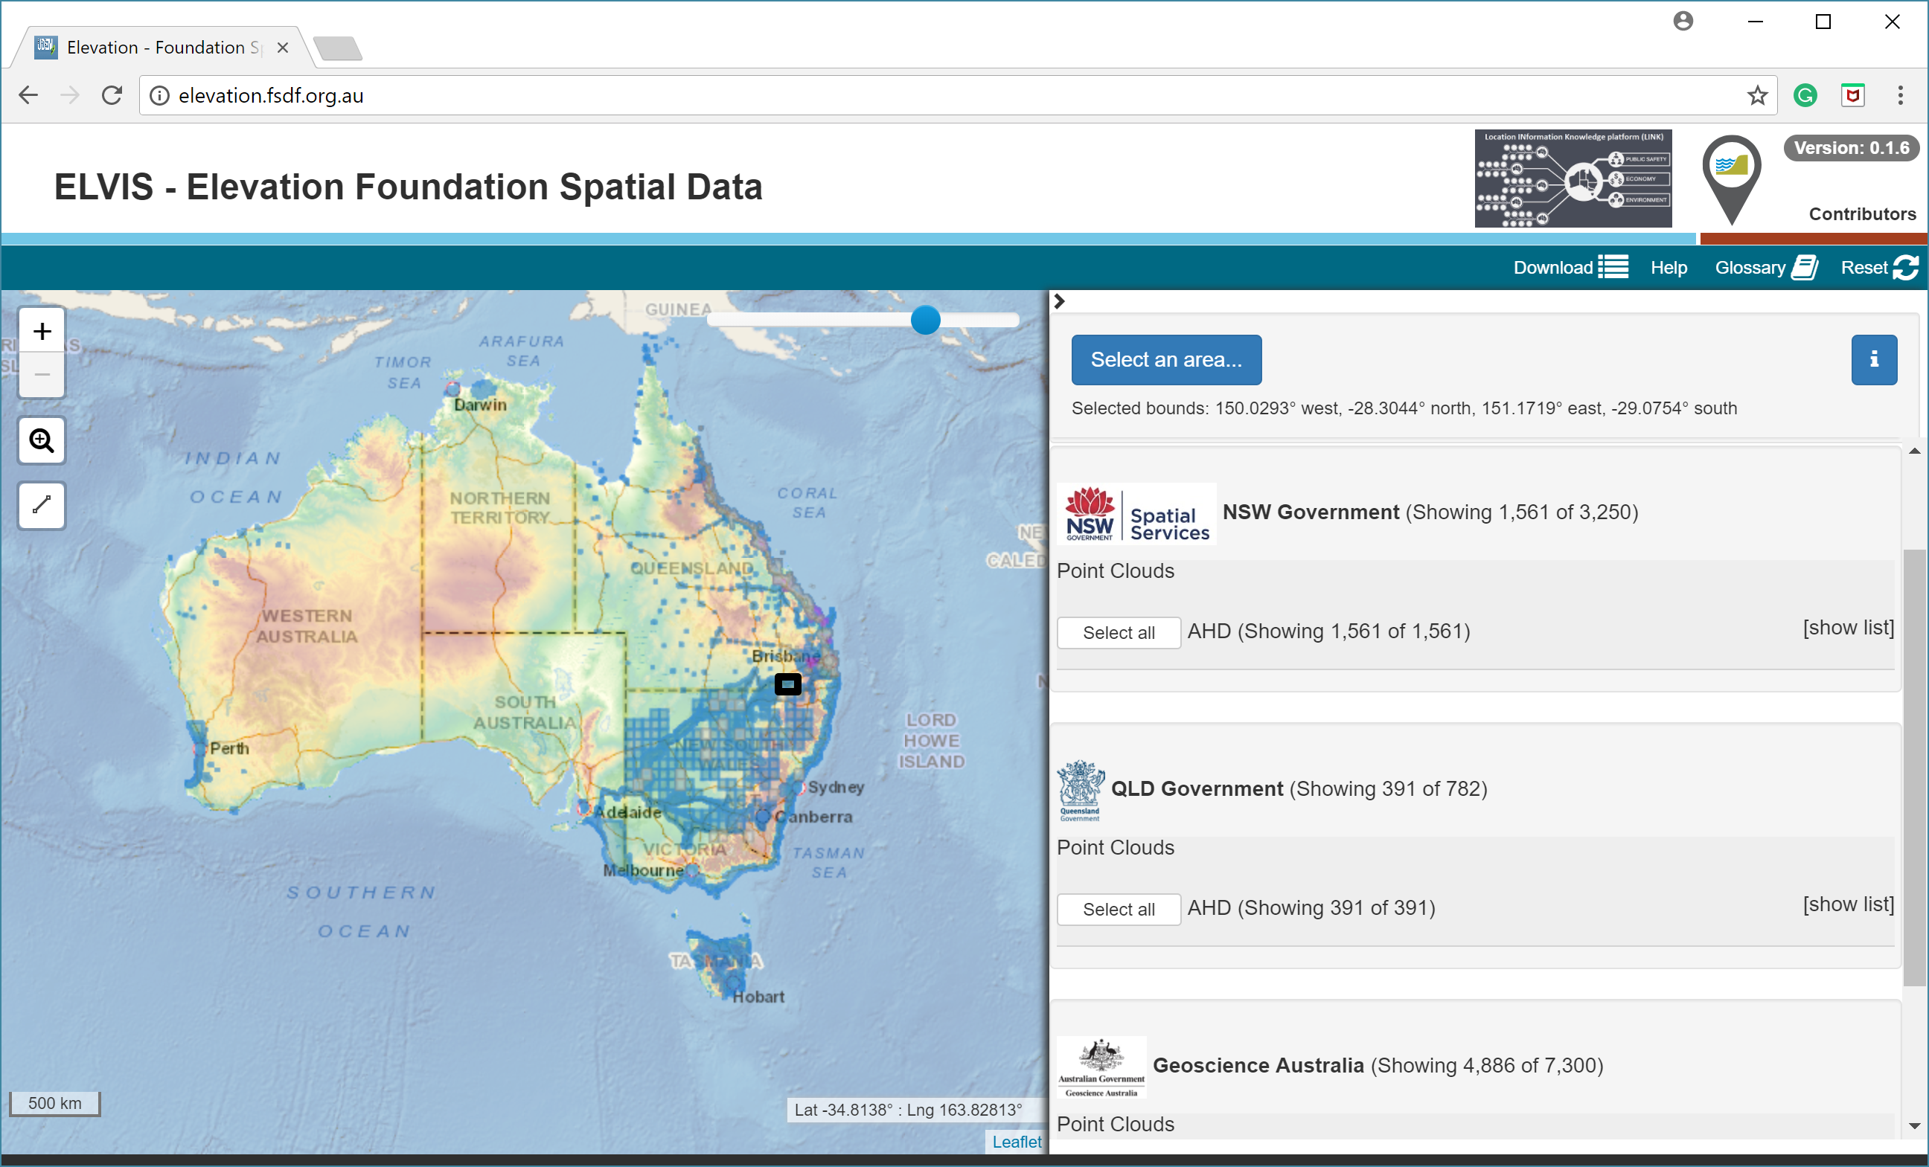
ELEVATION.FSDF.ORG.AU
Notes:
NSW, ACT, QLD, SA, TAS

Slide 25

The Shop, The Warehouse and The Factory
Data Storage and Packages Orders
Reporting and Statistics
Shop
Warehouse
Factory
Collects order instructions to send to warehouse
Transform Data
Clip
Portal A
QA incoming data from Suppliers
Inventory of what’s available for the shop
Builds packages for the warehouse
Delivery
Email Delivery via a link
Reporting
Links to Users
Portal B
Notes:
Elvis infrastructure

Slide 26
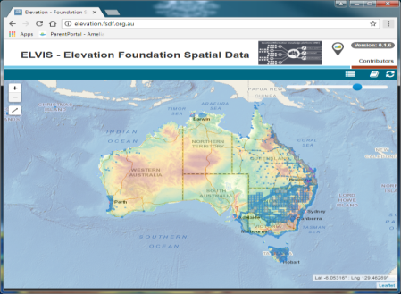


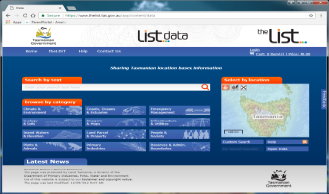

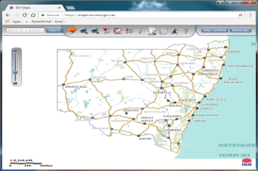
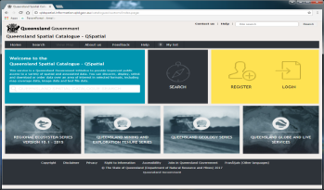
The ELVIS Infrastructure
API

Slide 27
Elevation Collaboration Benefits
Monthly
4000+ orders per month
~40 terabytes of free data to users
Currently 53 Terabytes stored in AWS within collaborators own buckets
GA does not manage anyone’s data, it just provides the infrastructure
~60 million dollars worth of data available
Significant reduction in costs across all jurisdictions currently involved
Growth in Use 1200 orders per year to currently 50,000 orders per year
This is an ICSM Infrastructure, managed by GA
Every Jurisdiction represented at Permanent Committee for Topographic Information (PCTI) has indicated they would like to have a presence ( GA, NSW, ACT, QLD, TAS, SA, WA, VIC, NT, Defence Hydro).
*Reporting and Statistics
Now have a new picture of who our data users are.
Soon will survey Users to built a better idea of the benefits they have realised from our collaboration.

Slide 28
ELVIS Costs
Storage and Delivery currently is covered by GA
Even if only GA data there are some fixed costs we would have
The jurisdictional data doesn’t add hugely to that cost
The cost of invoicing would be more than the cost recovered
The availability that working together creates with having all data in one place presents a significant future benefit
Store and Distribute the Data - Currently costing on average $1800 a month
Factory Costs – FME Cloud instance $21,000 Per Year
Staffing 1 Manager, 1 Data Management, 1 Cloud and FME technical Developer

Slide 31

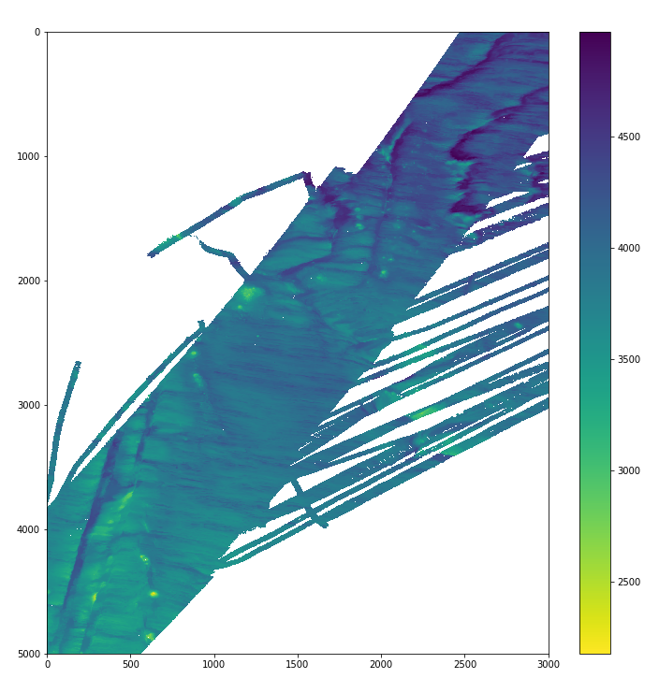
Point Cloud - Bathymetry processing with Spark (MH370 Phase 1) – Contracted SAGES (Polish company)
http://bit.ly/2wUwuC0
Approximately 45 min for >4.6 billion points (at 150m) using 8 m3.xlarge nodes,
approximately AUD$0.48
(previously > 8 hours)
Notes:
Mh370 example

Slide 32
Discussion points in groups (15 min + 15 min debrief)
What are the pros and cons of the proposed model?
Willingness to share and to what level?
What does sharing bring to you?
What are the barriers to adopting such model?
Are there other options for data management?
How does the data model fit with AODN?
What model to follow for 3rd-party acknowledgement for use of data

Slide 33
2b. Existing coverage compilation (10 min group discussion)
Background: At the last workshop, the group didn’t prioritise coverage. We decided that it would be better to work on a solution for displaying data points rather than compile data coverage from each agency.
Problem: Website portal include data coverage and stakeholder seem to appreciate it and want to see it completed.
Currently only consists of GA holdings
Action: Augment with other entities data holdings

Slide 34
Discussion points
Do we want to display shapefile coverage on the portal in the interim?
What does coverage mean (i.e. irregular polygon around data (high resolution grid), not bounding boxes; navigation track instead)
If data is not open, do we still want to display the coverage?
What timeframe?
first iteration
Updating frequency
Work towards automated upload
Who will lead this activity?

Slide 35
Workshop agenda:
18:30-18:45 What is AusSeabed and Updates on AusSeabed initiatives
18:45-19:45 QA4Multibeam (Nathan and Sam, FrontierSI)
Break
20:00 - 21:00 Data discoverability and accessibility (Dan, Deakin Uni & Kim, GA)
21:00 - 21:30 AusSeabed Steering committee and directions (Ralph, WA DoT)
21:30 - 21:45 AusSeabed and Seabed 2030

Slide 36
3. AusSeabed governance
Steering committee
Previously decision and direction of the working group have been run by a large email list with no set notion of quorum.
Time spent by that large group is extensive with little benefit except that all members are aware of what is evolving.
To improve the planning and decision-making process, we propose to form a steering committee to make these decisions on behalf of the group.
We hope to generally map the Steering committees ‘terms of Reference’ to operate by.
Outcomes
1. Decision on the steering committee representation and role
2. Terms of Reference, (dot points)
3. Reporting methods and frequency
Activity flow: 30 Minutes
Group discussion
(9:00pm - 20 minutes)
Final Outcomes
(9:20pm - 10 minutes)

Slide 37








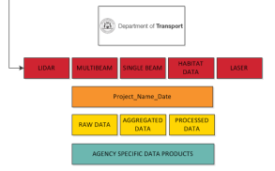
AusSeabed Steering Committee Example Tasks
User Discovery & Retrieval Process
Security and Administration Processes
Load and download processes
Folder structures etc

Slide 38



Building Blocks
Growing the Partnership
Marketing & Promotion
Neighbour Liaison

Slide 39
Discussion points
1. What do you want the Steering Committee to do (Short/Medium/Long term)?
• Guide future directions
• Drive activities
• Funding applications
• Review products
• Plan the workshops
2. What don’t you want the Steering Committee to do?
3. How long should the Steering committee exist for?
4. How do we elect/nominate a Steering committee?
Commonwealth gov., State gov., Industry, Academia
How do we choose a fair representation across the nation?
5. Have the people elected/nominated got the backing of their executive to pay and support their extra work and travelling to meet?
6. How often should the Steering committee meet or should they decide.
7. How is the Steering committee going to report back to you (Meeting-Newsletter)
Possible Meeting Schedule:
• Annual open meeting at AMSA (July) include a seabed mapping session and a 1 day AusSeabed-specific workshop
• Annual steering committee meeting (Nov or Feb)

Slide 40
Workshop agenda:
18:30-18:45 What is AusSeabed and Updates on AusSeabed initiatives
18:45-19:45 QA4Multibeam (Nathan and Sam, FrontierSI)
Break
20:00 - 21:00 Data discoverability and accessibility (Dan, Deakin Uni & Kim, GA)
21:00 - 21:30 AusSeabed Steering committee and directions (Ralph, WA DoT)
21:30 - 21:45 AusSeabed and Seabed 2030

Slide 41
4. AusSeabed and Seabed 2030
Background:
Seabed 2030 objective is to map the whole world ocean floor by 2030.
Seabed 2030 leading team is made up of 4 directors, each responsible for a region of the globe. Australia sits into 3 regional centres:
1. S and W Pacific region led by NIWA,
2. Atlantic and Indian Ocean led by Lamont-Doherty Earth Observatory.
3. Southern Ocean led by IBSCO
Outcome:
Decision on AusSeabed involvement with Seabed 2030 and communication flow.
Activity flow:
Group discussion

Slide 42
Discussion points
Should AusSeabed support and contribute to Seabed 2030? Could we be a “partner”?
If so, how can we contribute?
Data collation in the greater region of the Australian Marine Jurisdiction;
Promoting AusSeabed in other neighbouring countries;
Australian representative will be invited to Regional Data Assembly and Collation Centre (RDACC) meetings, what are we expecting from the representative?
Collate information from the group to inform the RDACC committee of Australia’s seabed mapping initiatives.
Disseminate information received at meetings back to the group
Representative should probably be on the SC
Need to be supported by own agency
Should AusSeabed suggests a representative? Do we agree on “who” is best placed?

Slide 43
Future focused activities for AusSeabed
Coverage
Survey register (automate, work with SOOS)
QA4MBES
Priority map (AusSeabed priority area survey)
Data management and discovery model
Website maintenance and improvement

Slide 44
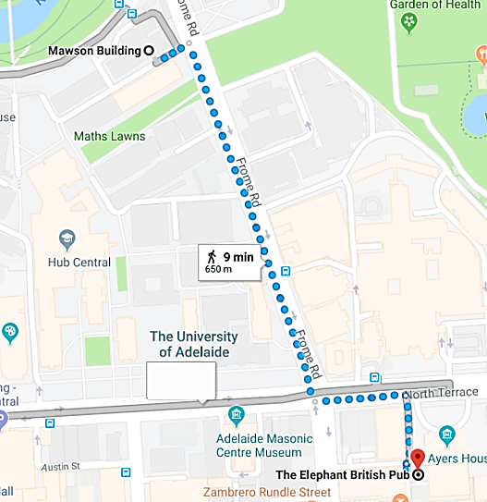
Post-workshop
Drinks at
The Elephant British Pub

Slide 45
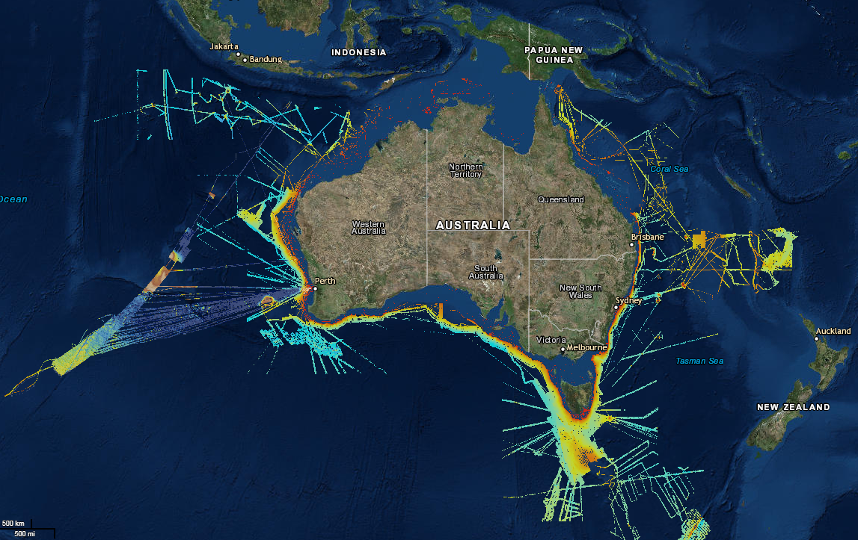
Want to be part of the effort?
Join the working group (OPEN to all)
Contact Kim Picard or Aero Leplastrier AusSeabed@ga.gov.au
Next meeting: TBC

